Slide 1
Data Science Lecture
By Botao Xu
30-July-2019

Slide 2
What does the lecture cover and what is purpose of the lecture?
Cover
Data science philosophies and principles
Data Science’s must-knows and tips
No Python or R coding at all
Purpose
Understand data science deeply
Apply data science more properly
Enable more efficient communication between data scientist and non-data scientist

Slide 3
Seven Data Science philosophies
Data and feature engineering determine the upper limit of model, all models and algorithms just approach this upper limit.
All models are wrong, but some are useful. - George Box
There is no free lunch.
Occam's razor.
Don’t over-rely on data science, domain knowledge might be one of the most important things.
Statistics is not mathematics, it is Art.
How do I trust your model and how to interpret model.
Torture the data, and it will confess to anything. — Ronald Coase (Nobel Prize in Economics1991)

Slide 4
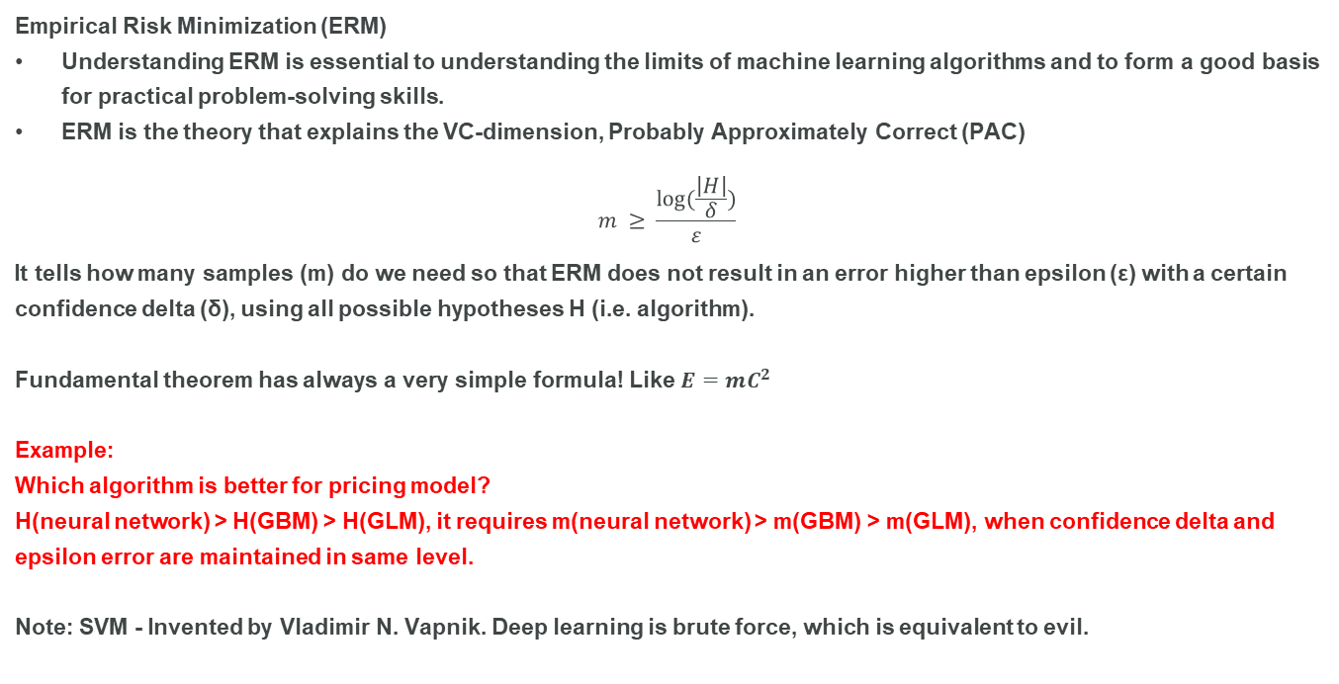
Machine Learning Fundamental Concept
Empirical Risk Minimization (ERM)
Understanding ERM is essential to understanding the limits of machine learning algorithms and to form a good basis for practical problem-solving skills.
ERM is the theory that explains the VC-dimension, Probably Approximately Correct (PAC)
$$m ≥ \frac{log(\frac{\left|H\right|}{δ})}{ε}$$
It tells how many samples (m) do we need so that ERM does not result in an error higher than epsilon (ε) with a certain confidence delta (δ), using all possible hypotheses H (i.e. algorithm).
Fundamental theorem has always a very simple formula! Like $E=mC^{2}$
Example:
Which algorithm is better for pricing model?
H(neural network) > H(GBM) > H(GLM), it requires m(neural network) > m(GBM) > m(GLM), when confidence delta and epsilon error are maintained in same level.
Note: SVM - Invented by Vladimir N. Vapnik. Deep learning is brute force, which is equivalent to evil.

Slide 5
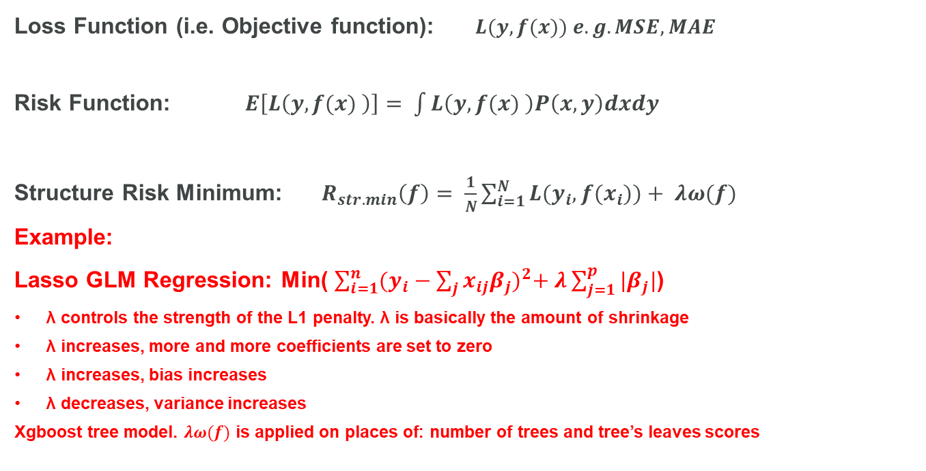
Loss Function, Risk Function and Structure Risk Minimum
Loss Function (i.e. Objective function): $L(y,f(x)) e.g. MSE, MAE$
Risk Function: $E\left[L\left(y,f(x) \right)\right]= \int{L\left(y,f(x) \right)P\left(x,y\right)dxdy}$
Structure Risk Minimum: $R_{str. min}\left(f\right)= \frac{1}{N}\sum_{i=1}^{N}{L(y_{i},f(x_{i}))}+ λω(f)$
Example:
Lasso GLM Regression: Min( $\sum_{i=1}^{n}{{(y_{i}−\sum_{j}{x_{ij}β_{j}})}^{2}+ λ\sum_{j=1}^{p}{|β_{j}|}}$)
λ controls the strength of the L1 penalty. λ is basically the amount of shrinkage
λ increases, more and more coefficients are set to zero
λ increases, bias increases
λ decreases, variance increases
Xgboost tree model. $λω(f)$ is applied on places of: number of trees and tree’s leaves scores

Slide 6
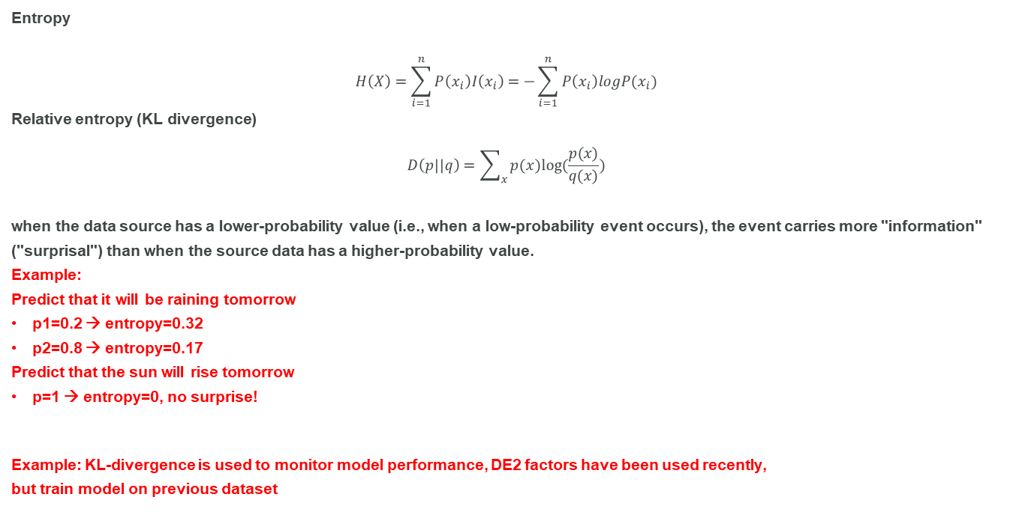
Information Entropy
Entropy
$$H\left(X\right)=\sum_{i=1}^{n}{P\left(x_{i}\right)I\left(x_{i}\right)=−\sum_{i=1}^{n}{P\left(x_{i}\right)logP(x_{i})}}$$
Relative entropy (KL divergence)
$$D\left(p||q\right)=\sum_{x}{p(x)log(\frac{p(x)}{q(x)})}$$
when the data source has a lower-probability value (i.e., when a low-probability event occurs), the event carries more "information" ("surprisal") than when the source data has a higher-probability value.
Example:
Predict that it will be raining tomorrow
p1=0.2 → entropy=0.32
p2=0.8 → entropy=0.17
Predict that the sun will rise tomorrow
p=1 → entropy=0, no surprise!
Example: KL-divergence is used to monitor model performance, DE2 factors have been used recently,
but train model on previous dataset
Various entropies
Joint entropy, Conditional entropy, Relative entropy, Mutual information.
Many modern algorithms are based on the measurement of entropy, e.g. T-SNE, GANs, Variational Inference MCMC, …

Slide 7
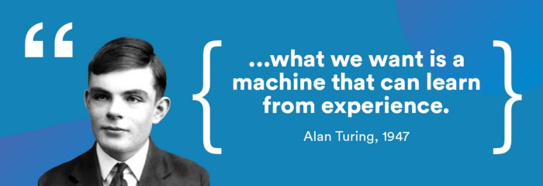
Bias-variance trade-off
In a nutshell, Bias-variance trade-off is just about how much should our model learns from our training data.
If it learns too much, we’d say it has ‘high variance’ and it would be ‘overfitting’ our data.
if it learns too little, it would have ‘high bias’ and the model would be ‘underfitting’ our training data.
We need to control how much is our model learning from the data

Slide 8
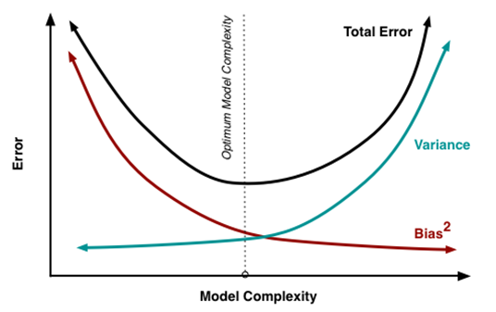
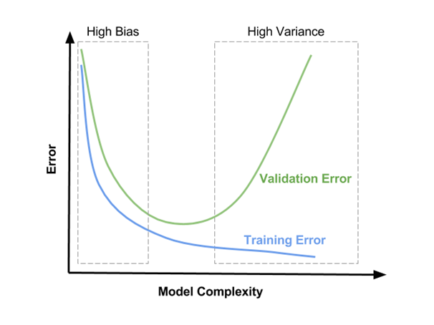
Bias-variance trade-off
What is bias and variance?
Bias. The error resulting from the difference between the expected value(s) of a model and the actual
Variance. The error resulting from the variability between different data predictions in a model
What is model complexity
Dataset (number of features, number of samples, etc.)
Algorithm
Type of algorithms (linear vs non-linear)
Hyperparameters in one algorithm (tree depth, L1/L2/gammar, etc.)
Hyperparameter optimization

Slide 9
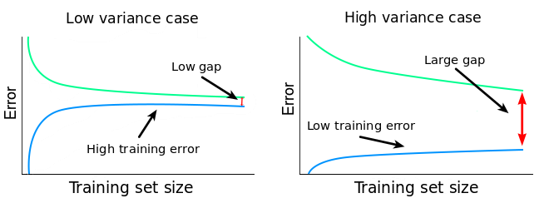
Bias-variance trade-off (Learning Curve)
high bias and low variance
adding more training data points won't lead to significantly better models.
we need to try something else, like switching to an algorithm that can build more complex models
Low bias and high variance
The large gap and the low training error also indicates an overfitting problem
Add more data or decrease complexity (no. of features, regularization, etc)

Slide 10
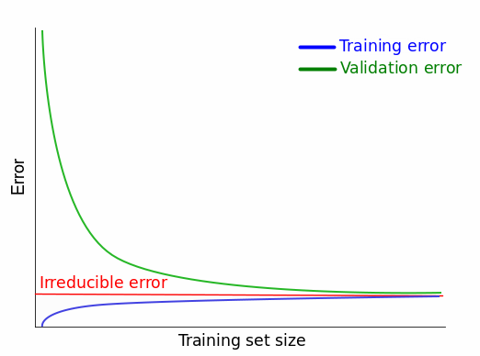
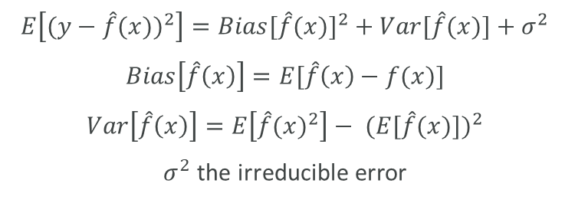
Bias-variance trade-off (Learning Curve)
Ideal learning curve
the best possible learning curves are those which converge to the value of some irreducible error, not toward some ideal error value
$$E\left[{(y−\hat{f}(x))}^{2}\right]={Bias[\hat{f}(x)]}^{2}+Var[\hat{f}(x)]+σ^{2}$$
$$Bias\left[\hat{f}\left(x\right)\right]=E[\hat{f}\left(x\right)−f(x)]$$
$$Var\left[\hat{f}\left(x\right)\right]=E\left[{\hat{f}(x)}^{2}\right]− {(E[\hat{f}(x)])}^{2}$$
$σ^{2}$the irreducible error

Slide 11
Machine Learning’s Fairness
How to know machine learning is biased (i.e. fairness)?
Note: this ‘biased’ should not be confused with ‘Bias-variance trade-off’
Where does ‘bias’ come from?
Input bias (e.g. data is out-of-date, old/young people lack of credit history)
Algorithm bias (e.g. Model is always in favour of majority class)
There are many metrics, picking the appropriate ‘FAIRNESS’ metrics
Disparate Impact
compares the positive predictions rates between protected population group and entire population
Equalized odds
true positive and false positive rates on a protected population group as those of the entire population
……

Slide 12
What are Regulators/government/institute doing regarding AI?
Who are looking at us? Or we can say from whom we can learn to make ourselves to comply policy better?
FCA (Financial Conduct Authority)
FRC (Financial Reporting Council)
Institute and Faculty of Actuaries (IFoA)
EU government (EU ethics guidelines for artificial intelligence)
UK parliament
IEEE (Institute of Electrical and Electronics Engineers)
TechUK
AI Council
Canada Algorithmic Impact Assessment Tool
AI Fairness 360
Other reasons to pay attention to above authorities/oganizations:
Notice updated informaiton
They consult experts who come from various industries, bring in new techniques, ideas and innovations

Slide 13
How to monitor model performance?
There are many metrics, most are comparing performance to train dataset. Deviation index = sum(% actual - % expected) x ln(%actual/%expected). It is baed on KullBack-Leibler divergence, i.e. KLpq + KLqp
For input variable. It is called characteristic index
For output variable. It is called stability index
Lift decay curve
Lift5Decay, Lift10Decay, etc.
Gini decay curve
KS statistic. It measure vertical distance between CDF and ECDF
MSE,MAE,…
……
Set Alert and Warning Conditions.

Slide 14
How to use Classification Metrics?
Basically, there are two scenarios:
Balanced data
Imbalanced data
Imbalanced case:
Don’t use accuracy
Use PR-curve, f1, custom metric, in addition to ROC curve
Two types of error:
False Positive Type I error
False Negative Type II error
Example:
Life critical case. Medical application, Type II error is dangerous!
Costly case. Fraud detection, Type II error cost much resource (man hours)
 |  | True outcome
 |  | 0 | 1
Predicted Outcome | 0 | True Negative (TN) | False negative (FN)
 | 1 | False Positive (FP) | True Positive (TP)

Slide 15
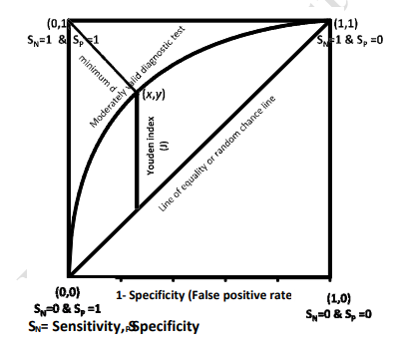
How to determine optimal threshold of ROC (Receiver operating characteristic) curve?
There are a number of criteria are used to find optimal, mainly include two types:
Give equal weight to sensitivity and specificity, and impose no constraints
Consider cost which mainly includes financial cost for correct and false classification
Three criteria:
Criteria -1 Youden Index maximizes the vertical distance from line of equality (diagonal line) to the point [x, y] of ROC curve.
Criteria-2 Minimise the distance between Points on ROC curve and (0, 1), i.e. closest to the (0, 1)
Criteria-3 cost based
Example:
Insurance customer conversion model, by default, probability >=0.5
is classified as successful conversion, the value of 0.5 is
not optimal one but convenient to be used.
Using optimal threshold make your model more predictive.
Several important metrics:
Sensitivity (recall, TPR, hit-rate) = TP / (TP+FN)
Specificity (TNR) = TN / (FP+TN)
PPV (precision) = TP / (TP + FP)

Slide 16
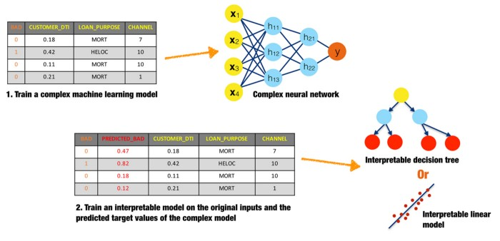
How to interpret machine model?
Main Interpretability Methods
Workarounds to Complex Models
Surrogate Models
Ensemble Modelling (weakers → stronger)
Global and Local Explanations
Partial Dependence Plots (PDP)
Individual Conditional Expectation (ICE)
Locally Interpretable Algorithms
LIME(Local interpretable model-agnostic explanations)
SHAP(SHapley Additive exPlanations)
ELI5 (Explain Like I’m 5)
Surrogate model - using the independent variables from input data and the prediction from the black box as the dependent variable, then evaluate how good the surrogate model is.
“Interpretable Machine Learning-A Guide for Making Black Box Models Explainable”
https://christophm.github.io/interpretable-ml-book/

Slide 17
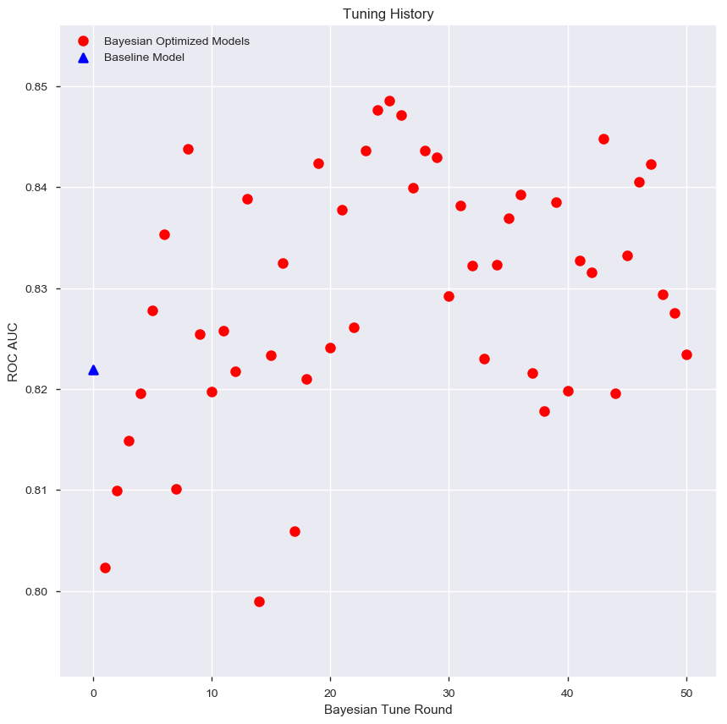
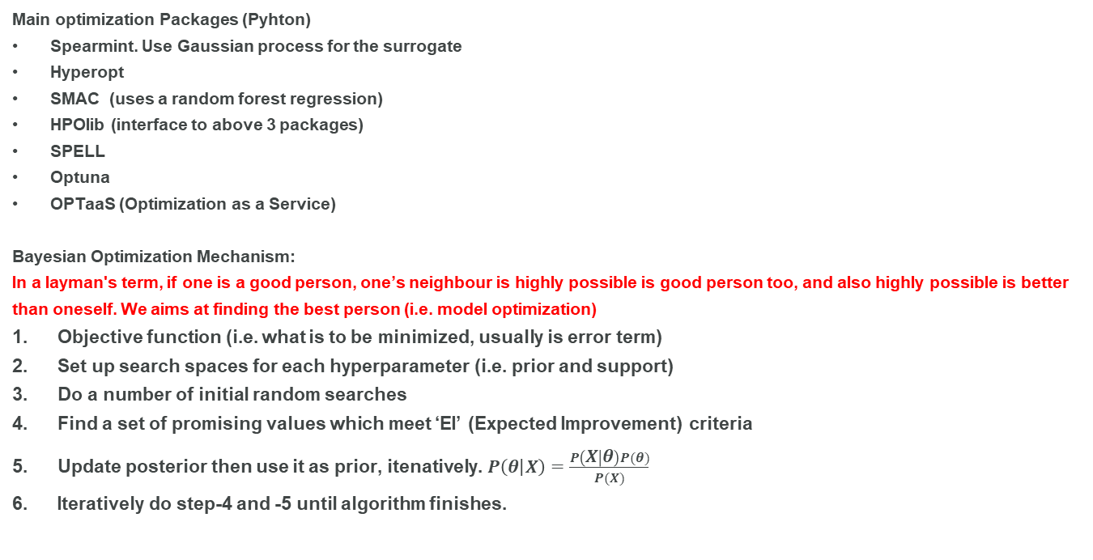
How to optimize machine model?
Main optimization Packages (Pyhton)
Spearmint. Use Gaussian process for the surrogate
Hyperopt
SMAC (uses a random forest regression)
HPOlib (interface to above 3 packages)
SPELL
Optuna
OPTaaS (Optimization as a Service)
Bayesian Optimization Mechanism:
In a layman's term, if one is a good person, one’s neighbour is highly possible is good person too, and also highly possible is better than oneself. We aims at finding the best person (i.e. model optimization)
Objective function (i.e. what is to be minimized, usually is error term)
Set up search spaces for each hyperparameter (i.e. prior and support)
Do a number of initial random searches
Find a set of promising values which meet ‘EI’ (Expected Improvement) criteria
Update posterior then use it as prior, itenatively. $P\left(θ | X\right)=\frac{P\left(X | θ\right)P(θ)}{P(X)}$
Iteratively do step-4 and -5 until algorithm finishes.

Slide 18
How to deal with outliers?
What is outliers?
Outliers are extreme values, these extreme values can be present in both dependent & independent variables, in the case of supervised learning methods.
These extreme values need not necessarily impact the model performance or accuracy, but when they do they are called “Influential” points.
Ask three questions before do anything
Do you have outliers in your dataset?
Are you sure they are outliers?
Or they are just unexpected values we should still care about?
Example:
Claim fraudulent detection. Outliers may be those who are fraudulent claimers

Slide 19
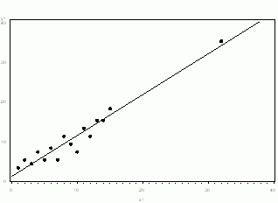
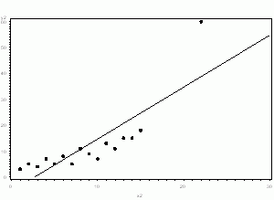
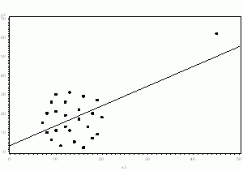
How to deal with outliers?
To Drop or Not to Drop Outliers:
If it is obvious that the outlier is due to incorrectly entered or measured data, you should drop the outlier.
If the outlier does not change the results but does affect assumptions, you may drop the outlier. But keep a note of it.
If the outlier affects both results and assumptions, we cannot simply drop the outlier. We need to run the analysis both with and without it, and keep a not of how the results changed by dropping the outlier.
If the outlier creates a significant association, you should drop the outlier and should not report any significance from your analysis.
Example:
Age or min experience beyond assumption, e.g. 100
In the following graph, the relationship between X and Y is clearly created by the outlier. Without it, there is no relationship between X and Y, so the regression coefficient does not truly describe the effect of X on Y.

Slide 20
How to deal with outliers?
Solution when Not to Drop Outliers:
Data level
Log transformation
Box-Cox transformation
Grouping to bins
Winsorize (cap at threshold)
Algorithm level
Use outliers robust function. MAE vs MSE
Use balancing function like Minkowski loss, Huber loss
Use outliers robust algorithm. Xgboost vs GLM
Example:
Selecting proper objective function in model improves model performance, e.g.
Expectation of MSE leads to mean unbiased estimation
Expectation of MAE leads to median unbiased estimation

Slide 21
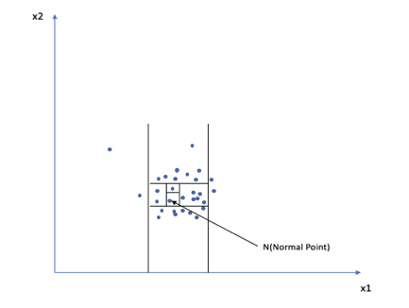
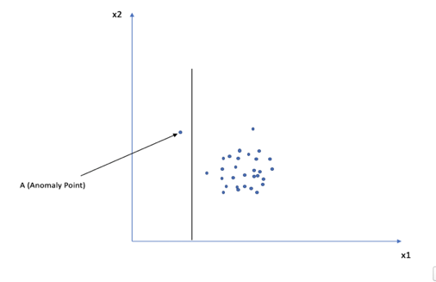
How to detect outliers?
Algorithms:
Regular shapes
K-mean (hard clustering)
Irregular shape
DBSCAN
GMM (soft clustering)
Autoencoder
Isolation Forest
Above algorithms are used for clustering too.
Example:
Removing outliers from raw input usually improve model performance
Isolation forest. Basically speaking, the normal points are easy to split, while the anomaly points are not easy be split. i.e. how many splits are used to separate one data point. Anomaly point only need small number of splits.

Slide 22
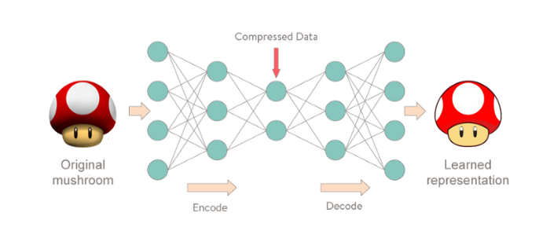
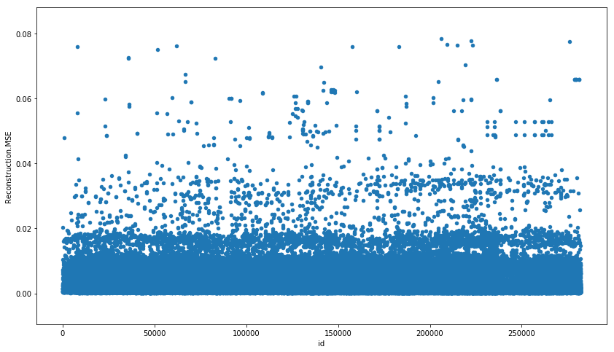
How to detect outliers?
Example: Auto encoder (Neural Network) on Taxi TPD Freq. Claim data
Application:
Generate two new features (Feature engineering)
Detect outliers and remove them (Unsupervised ML)
Fraudulent claim detection (Supervised ML)

Slide 23

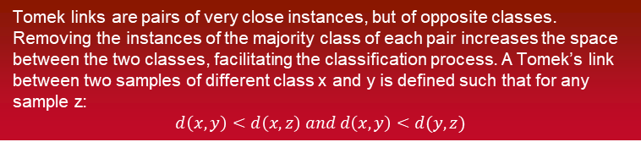
How to deal with imbalanced problem?
Tomek links are pairs of very close instances, but of opposite classes. Removing the instances of the majority class of each pair increases the space between the two classes, facilitating the classification process. A Tomek’s link between two samples of different class x and y is defined such that for any sample z:
$$d\left(x,y\right)<d\left(x,z\right) and d\left(x,y\right)<d(y,z)$$
Algorithm always favour the majority!
Solution:
From data perspective (Re-sampling)
Over-sampling,
under-sampling,
SMOTE (ADASYN)
Tomek links
SMOTE (ADASYN) + Tomek links
Form algorithm perspective (Cost sensitive)
More weight on minority class than majority class
Add more penalty on mis-classified minority class than majority class
Note: Make sure to re-sample after creating the train/test split, so that you only oversample the train data
Example:
Most insurance data is imbalanced data, majority policyholder don’t claim, majority claimers are not fraudulent claim,etc.

Slide 24
How to select a proper objective function?
Based on target distribution
Regression: Poisson, Gamma, tweedie
Classification: accuracy, auc, logloss
Based on input distribution
Regression: MSE (RMSE), MAE, Huber, …
Classification:
Based on algorithm
Soft vs hard voting

Slide 25
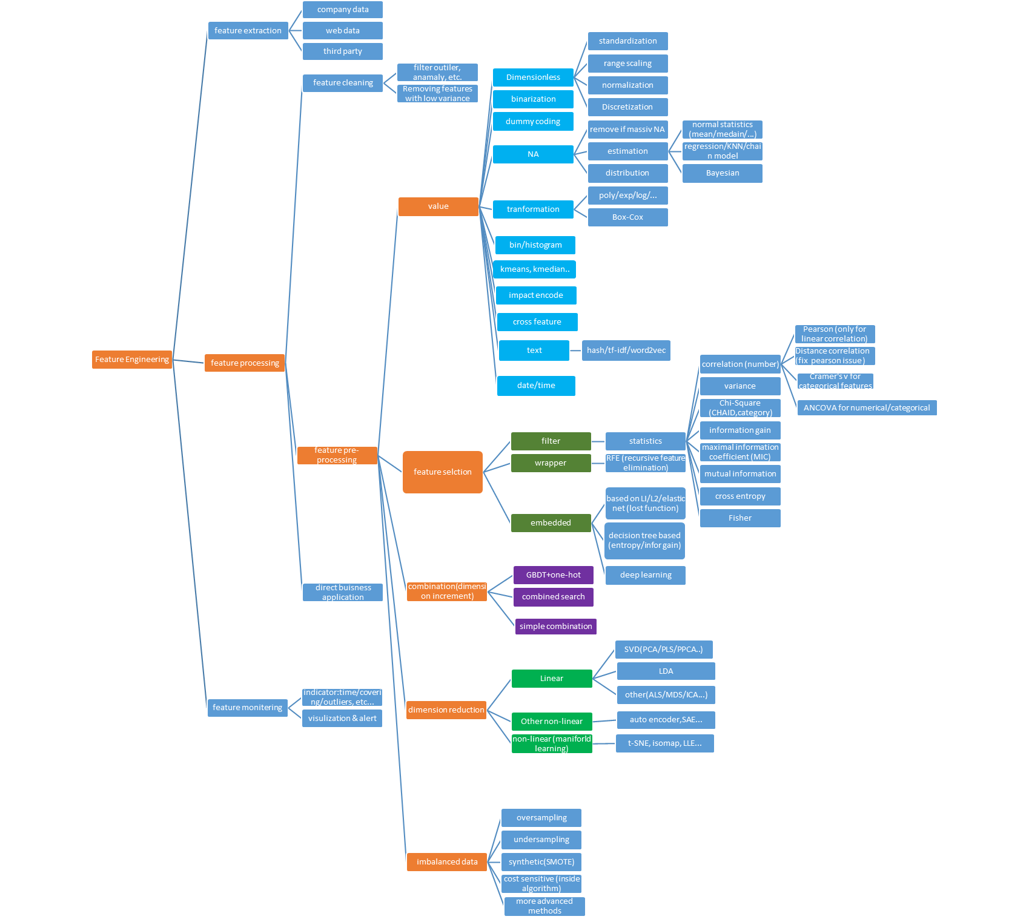
What feature engineering do we have?
Rule of Thumb: Feature engineering is more important than algorithms!
Top reasons to use feature selection are:
It improves the model accuracy
It speeds up machine learning train
It reduces model complexity
It reduces overfitting.
Example: create new vehicle feature by length x width,
Or use Deep feature synthesis (DFS) from package “featuretools”

Slide 26
How to deal with categorical features with high cardinality?
Why one-hot is not good
Increase dimensions
it request deep tree structure before fully use all levels
Sparsity
The most advanced categorical encoding
Impact/effect encoding (Bayesian regression)
Homogeneity grouping (LightGBM)
Method based on (CatBoost)

Slide 27
What is missing values mechanism?
Three missing value mechanisms
MCAR means that the missing data mechanism is unrelated to the values of any variables, whether missing or observed.
MAR requires that the cause of the missing data is unrelated to the missing values but may be related to the observed values of other variables
MNAR that the missing data mechanism is related to the missing values.
A key distinction is whether the mechanism is ignorable (i.e., MCAR or MAR) or non-ignorable (MNAR).
There are excellent techniques for handling ignorable missing data.
Non-ignorable missing data are more challenging and require a different approach.
Example:
Modelling weight (Y) as a function of sex (X). Some respondents wouldn't disclose their weight, so we are missing some values for Y.
There may be no particular reason why some respondents told you their weights and others didn't. That is, the probability that Y is missing may has no relationship to X or Y. In this case our data is missing completely at random (MCAR)
One sex may be less likely to disclose its weight. That is, the probability that Y is missing depends only on the value of X. Such data are missing at random (MAR)
Heavy (or light) people may be less likely to disclose their weight. That is, the probability that Y is missing depends on the unobserved value of Y itself. Such data are not missing at random or missing not at random (MNAR)

Slide 28
How to deal with missing values?
Imputation
MICE (most famous method)
KNN
Regression
Machine Learning model
Methods
Single multivariate imputation
Multiple multivariate imputation

Slide 29
Classification Metrics
Most common metrics for Binary classification (yes or no)
ROC curve and AUC
PR curve
f1 (harmonic mean)
Recall (sensitivity, hit-rate, True Positive Rate)
Precision
3 Types model performance
High Precision + High Recall — It is perfect model.
Low Recall + High Precision — This just means the model is very picky. Such models cannot be used for life critical data e.g. disease detection, terrorist identification, accident prevention etc. it is still a trustable model, i.e. what the model predict as positive case is truly happened.
High Recall+ Low Precision — The model is able to detect most of the positives well but ends up creating a lot of false alarms. Such models should not be used for cases where false alarms have a huge cost — e.g. finance fraud detection etc. Note that such models can work for life critical situations.
Example: for insurance fraudulent claim detection, High Recall+ Low Precision is not feasible to use
 |  | True outcome
 |  | 0 | 1
Predicted Outcome | 0 | True Negative (TN) | False negative (FN)
 | 1 | False Positive (FP) | True Positive (TP)

Slide 30

Distance – It will either make you or break you!
Distance
In ML, many algorithms are implemented through ‘distance’ measurement
MSE, K-Means, KNN, PCA, …
Aka. Similarity
Most popular distance is Euclidian distance
Easy to use and understood
Can’t deal with missing value, inf, …
Sensitive to magnitude, thus request scaling before modelling, e.g. height and age.
Less accurate in high-dimensional space (think about swiss role)
Smarter way to use ‘distance’
Select proper ‘distance’ type
Heterogeneous Euclidean-Overlap Metric (HEOM)
Manifold learning
Handling high dimensional space for dimension reduction
Feature Boosting
more important features, by multiplying them by a number>1
Example: customer segmentation, using Feature Boosting on age, min_experience which are more important
than other features
Minkowski distance:
When p=1, it is Manhattan distance
When p=2, it is Euclidian distance
$$d=({\sum_{i=1}^{n}{\left.{|X_{i}^{a}−X_{i}^{b}|}^{p}\right)}}^{\frac{1}{p}}$$

Slide 31
How to avoid overfitting?
Algorithm levels
cross-validation and early-stop
Regularization l1, l2
Other hyperparameters: gamma, min_child_weight, etc.
Model Selection Algorithms but end up losing valuable information
Simply the model
Dataset levels
check input distribution
Reduce Features
Feed More Data (using learning curve to determine if this works or not)
add noise into data to make model more robust
You model can only store so much information. This means that the more training data you feed it, the less likely it is to overfit. The reason is that, as you add more data, the model becomes unable to overfit all the samples, and is forced to generalize to make progress.

Slide 32
How to do train-test splits?
Two basic rules:
Usually a 80–20 or 70–30% train-test split is considered reasonable.
In case of classification problem, we should always use stratified sampling (stratified k-folds) instead of random sampling.
Stratified sampling has several advantages over simple random sampling
It maintains the proportion of target classes in train and test datasets.
it may be possible to reduce the sample size required to achieve a given precision.
it may be possible to increase the precision with the same sample size.
Caution:
Setup random seeds to make sure other uses generate same results after run your code.
Easy to use:
from sklearn.model_selection import train_test_split
X_train, X_test, y_train, y_test = train_test_split(your_data, y, test_size=0.2, stratify=y, random_state=123, shuffle=True)

Slide 33
Ho to use cross-validation technique on a time series dataset?
Time series is not randomly distributed data, it is inherently ordered by chronological order.
fold 1 : training [1], test [2]
fold 2 : training [1 2], test [3]
fold 3 : training [1 2 3], test [4]
fold 4 : training [1 2 3 4], test [5]
fold 5 : training [1 2 3 4 5], test [6]

Slide 34
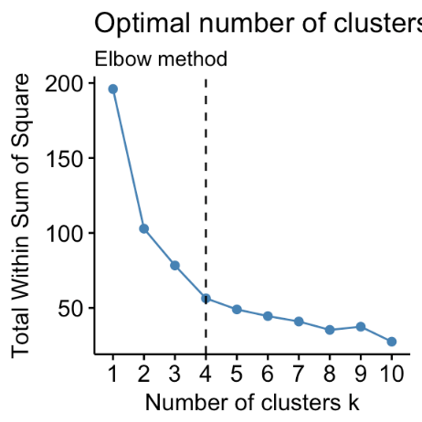
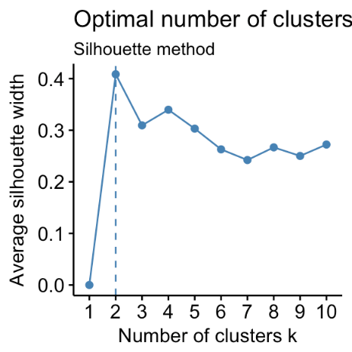
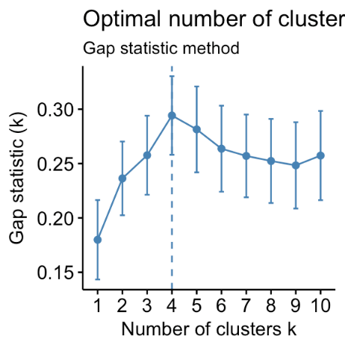
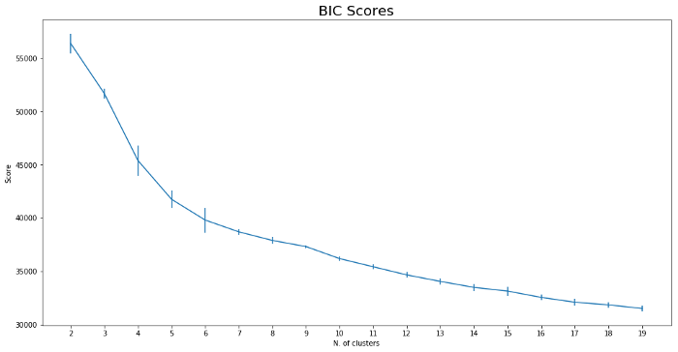
How to determine optimal k for clustering?
Optimal k number:
Elbow method
Silhouette method
Gap statistic method
Gradient of Bayesian information criterion (BIC)

Slide 35
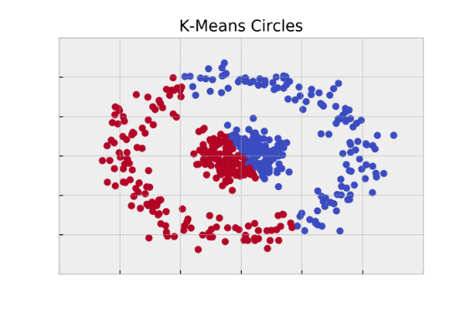
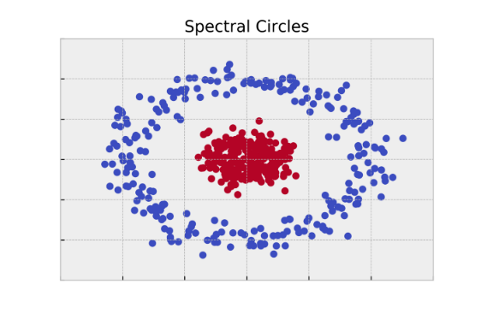
Other clustering algorithms
K-means is most used clustering algorithm, but it use Euclidian distance (not good for irregular shape), it needs to use other algorithms:
DBSCAN
Spectral clustering
t-distributed stochastic neighbor embedding
…
Spectral clustering
It is based on graph theory
Use eigenvectors to define features
Use k-means group features into clusters

Slide 36
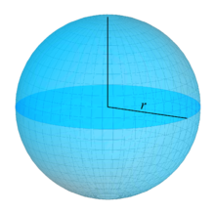
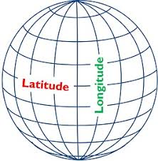

Dimensional Reduction
Euclidian space (3 features): ${(x−x_{0})}^{2}+{(y−y_{0})}^{2}+{(z−z_{0})}^{2}=r^{2}$
Simply speaking, dimension is the number of random variables (i.e. features) in dataset.
Dimensional reduction algorithms can be categorized into types:
Linear vs non-linear
Unsupervised vs supervised
main algorithms:
PCA
LSA
Autoencoder
Manifold learning (t-SNE, Spectral Embedding, etc.)
…
Advantages:
Compress data and reduce storage space.
Maintain statistical significance of modelling
Reduces computation time.
Remove redundant features, if any.
Disadvantages:
May lead to some amount of data loss
Increase difficulty of model interpretability
Manifold space (2 features):
Latitude and Longitude

Slide 37
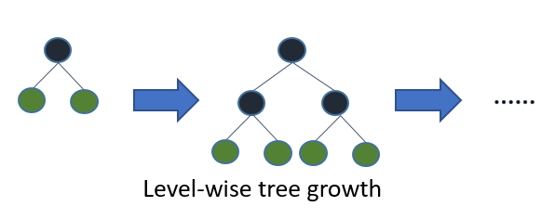
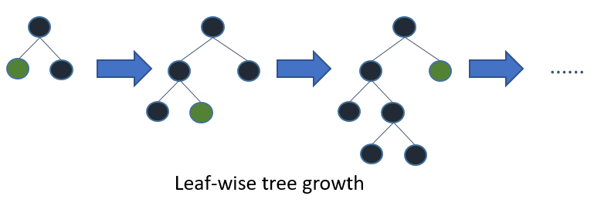
Advanced tips to use Xgboost
Presumably you are already familiar with normal usage of Xgboost, the following is how to use it in advanced way.
Grow policy – Leaf wise
Monotonic Constraints
Feature interaction constraints
Balanced algorithm – negative/positive
Random Forest
Refresh trees -“Transform Learning”
Distributed with Kubeflow, spark
Example: AD risk has monotonic relation with ‘local_criminal_rate’

Slide 38
Worldview : Frequentist or Bayesian
What is Statistics
State + tistics
Use samples to Inference population
Want to find out the characteristic (θ) of population, e.g. mean, scale, …
Frequentist vs Bayesian
Frequentist purely use observed events to inference entire events, while Bayesian use ‘prior belief’ and observed events to update posterior belief.
Frequentist consider θ is fixed and sample is random variable, while Bayesian consider θ is random variable and samples is fixed.
Frequentist use confidence interval and level to define θ while Bayesian use distribution to define θ.
To be p-value or not to be p-value
Main argument – θ is existing although we don’t know exact value vs θ is impossible to know thus it is a random variable. Like argument between relative theory and quantum - Does God Play Dice?

Slide 39
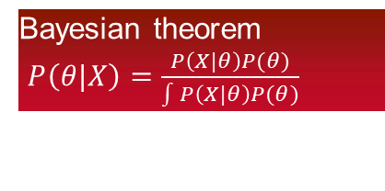
Worldview : Frequentist or Bayesian
Bayesian
Be Significantly developed and applied recently thanks to modern computational power
Tomas Bayes (1702 – 1761)
Formula is not tractable, e.g. impossible to integrate
Even don’t know what distribution it is
Very few conjugate prior distributions
Many modern ML make use Bayesian theorem
First development
M-H algorithm (Manhattan project)
Monte Carlo simulation (Manhattan project)
Morden packages
Stan (Stanislaw Ulam)
Edward (George Edward Pelham Box)
PyMC3
Two main techniques
MCMC
Variational inference
Example: insurance large loss ratio
Bayesian theorem
$P\left(θ|X\right)=\frac{P\left(X|θ\right)P(θ)}{\int{P\left(X|θ\right)P(θ)}}$

Slide 40
The most useful distribution - Gaussian distribution
Why Gaussian distribution is so useful to data scientist?
It is named after the genius of Carl Friedrich Gauss.
Only two parameters (mean and standard deviation), pdf is easy to use
symmetric
many variables approximately normally distributed
Well-understood
mean=mode=median
CLT convert any distribution into normal distribution
Once a Gaussian, always a Gaussian! if A and B are two variables with normal distributions then: A x B is normally distributed. A + B is normally distributed, Fourier transform of Gaussian is a Gaussian, Convolution of Gaussian with another Gaussian is a Gaussian.
What If The Sample Distribution Is Not Normal?
Linear Transformation (i.e. z-score=(x-mean)/standard deviation)
Boxcox Transformation (scipy.stats.boxcox(x, lmbda=None, alpha=None))
Yeo-Johnson Transformation (sklearn.preprocessing.PowerTransformer(method=’yeo-johnson’, standardize=True, copy=True))

Slide 41
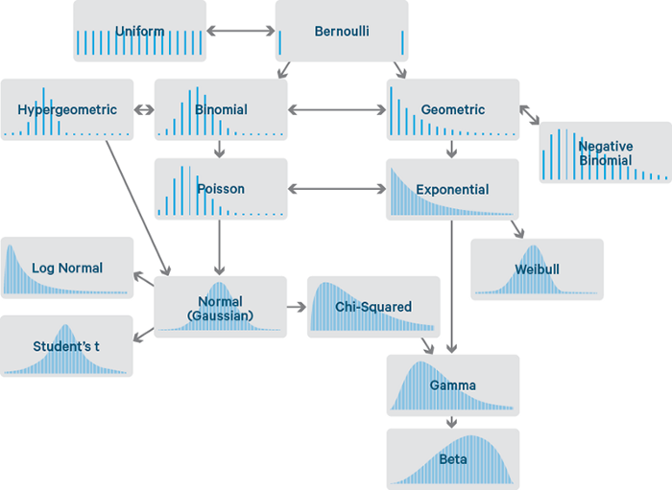
Probability Distributions in Data Science

Slide 42
The six discrete distributions every Data Scientist should know
Bernoulli Distribution
A Coin is tossed with probability p of heads
Binomial Distribution
Probability of getting exactly k successes in n trials
Geometric Distribution
The number of failures before the first success(Heads) when a coin with probability p is tossed
Negative Binomial Distribution
The number of failures of independent Bernoulli(p) trials before the rth success
Poisson Distribution
count the successes of a large number of trials where the per-trial success rate is low
Exponential Distribution
survival analysis, the expected life of a wash machine

Slide 43
Future
Due to time limit…

